Slide 1

Stock AI Assistant 2nd Hons Meeting Finn Zhan Chen - 28th Novermber 2018

Slide 2
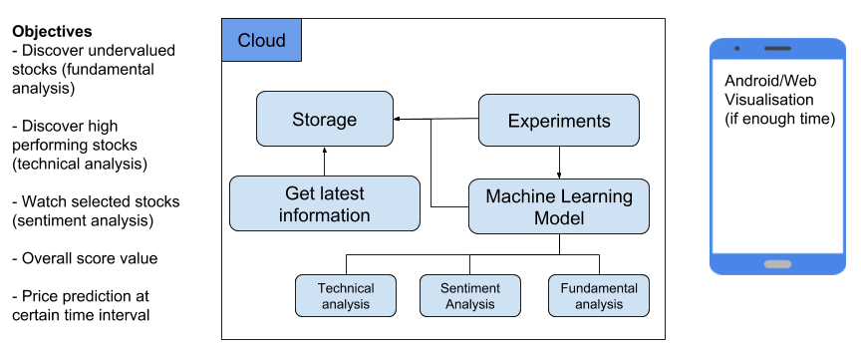
Project Overview

Slide 3
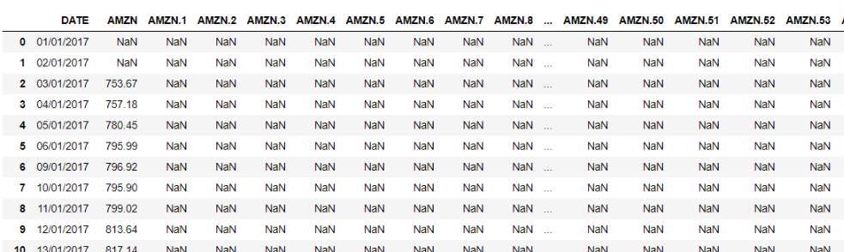
Current Progress: System Design
Dataset ready to be used

Slide 4
Current Progress: System Design
58 indicator explained (subset shown below)
Share Price | EBITDA | Current Assets | Revenues | Net Income from Discontinued Op. | Total Noncurrent Assets | Total Noncurrent Liabilities | Receivables | Current Liabilities | Treasury Stock | Cash From Financing Activities
Common Shares Outstanding | Interest expense, net | Net PP&E | COGS | Net Profit | Total Assets | Total Liabilities | Cash From Operating Activities | Total Equity | Retained Earnings | Net Change in Cash
Avg. Basic Shares Outstanding | Abnormal Gains/Losses | Intangible Assets | SG&A | Dividends | Short term debt | Preferred Equity | Net Change in PP&E & Intangibles | Depreciation & Amortisation | Equity Before Minorities | Free Cash Flow
Avg. Diluted Shares Outstanding | Income Taxes | Goodwill | R&D | Cash and Cash Equivalents | Accounts Payable | Share Capital | Cash From Investing Activities | Change in Working Capital | Minorities | Gross Margin

Slide 5
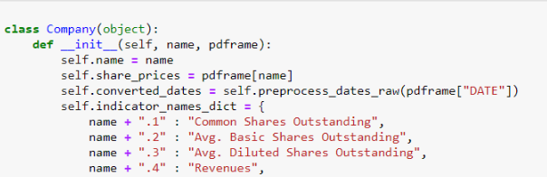
Current Progress: System Design
Object oriented approach to data

Slide 6
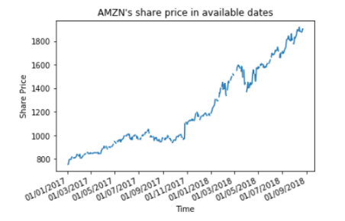
Current Progress: System Design
Share price visualisation

Slide 7
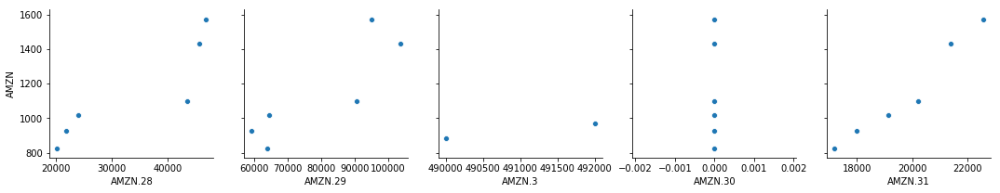
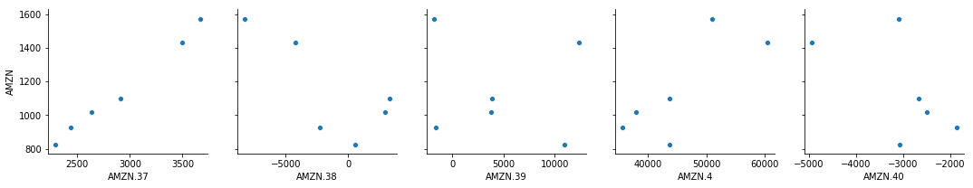
Current Progress: System Design
Indicator’s correlation to share price (indicator are from quarterly results, hence small datapoints)

Slide 8
Current Progress: System Design
Indicator’s correlation to share price in numbers
1.000 AMZN.57: Market Capitalisation
0.999 AMZN.58: Enterprise Value
0.995 AMZN.37: Depreciation & Amortisation
0.986 AMZN.36: Total Equity
0.976 AMZN.31: Share Capital
0.967 AMZN.33: Retained Earnings
0.949 AMZN.19: Net PP&E
0.936 AMZN.10: Interest expense, net
0.925 AMZN.22: Total Noncurrent Assets
0.915 AMZN.6: SG&A
0.913 AMZN.23: Total Assets
0.904 AMZN.9: EBITDA
0.892 AMZN.17: Receivables
0.884 AMZN.28: Total Noncurrent Liabilities
0.866 AMZN.29: Total Liabilities
0.568 AMZN.25: Accounts Payable
0.508 AMZN.16: Cash and Cash Equivalents
0.497 AMZN.46: Operating Margin
0.269 AMZN.50: Current Ratio
0.264 AMZN.51: Liabilities to Equity Ratio
0.235 AMZN.41: Cash From Investing Activities
0.196 AMZN.53: EV / EBITDA
0.129 AMZN.56: Operating Income / EV
-0.033 AMZN.43: Net Change in Cash
-0.119 AMZN.39: Cash From Operating Activities
-0.183 AMZN.42: Cash From Financing Activities

Slide 9
Current Progress: Next Steps
LSTM Data Preparation
Transform the time series into a supervised learning problem
Transform the time series data so that it is stationary.
Transform the observations to have a specific scale.
LSTM Stock Prediction
Parameter optimisation
Sliding Window vs Vector Auto Regression
One-step vs Multi-step forecasting
Univariate (Share price only) vs Multivariate Time series (Share price and other indicators)

Slide 10
Current Progress: Next Steps
Evaluation
Compare to baseline models like Persistence Model Forecast
Training, validation, and testing set
Industry specific performance
100+ companies with from 13 different industries such as Utilities, Construction, and Manufacturing
Use this to help predicting fundamental and technical performance

Slide 11
Gantt Chart
Timeline
Semester 1:
Focus on full-time job hunt
Focus on planning Hons project
Focus on Masters application
Semester 2:
Minimal work from other courses, can devote almost full-time for Hons project
Data source mining
Sep
Research & Reading
Oct
System Design
Nov
Development
Dec-Mar
Interim Write-up
Jan
Visualisation
Mar
Final Write-up
Mar-Apr
Submission
(4 Apr 2019)
Start
Semester 1
Semester 2

